Slide 1
ANALYSING SPENDING BEHAVIOUR AND IDENTIFYING OPPORTUNITIES FOR GROWTH
PROJECT REPORT

Slide 2
INTRODUCTION 1.1 Overview
Unveiling Market Insights is the sale of goods or merchandise to retailer to industrial, commercial, institutional or other professional businessman to other wholesalers and related subordinated services.
In other words , it is the sale of goods in bulk to anyone, either a person or an organization, other than the end consumer of that merchandise.
It can be described as wholesale business

Slide 3
1.2 PURPOSE
Unveiling Market Insights identifies opportunities for growth
It helps to compete more effectively
It improves the production in industries

Slide 4
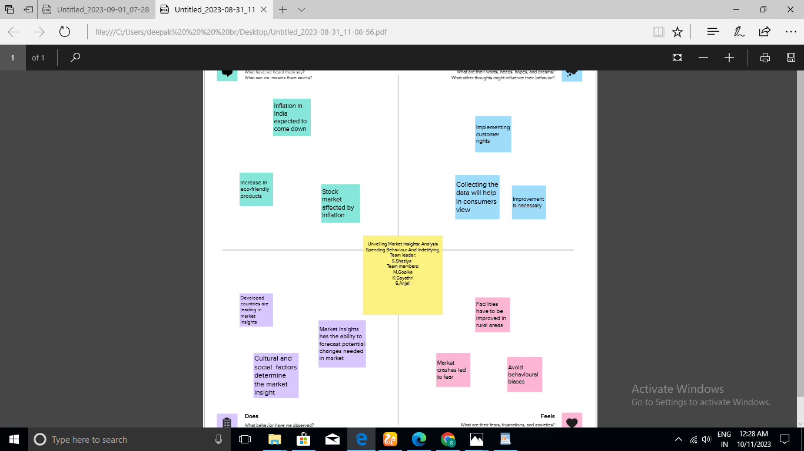
2.1 EMPATHY MAP

Slide 5
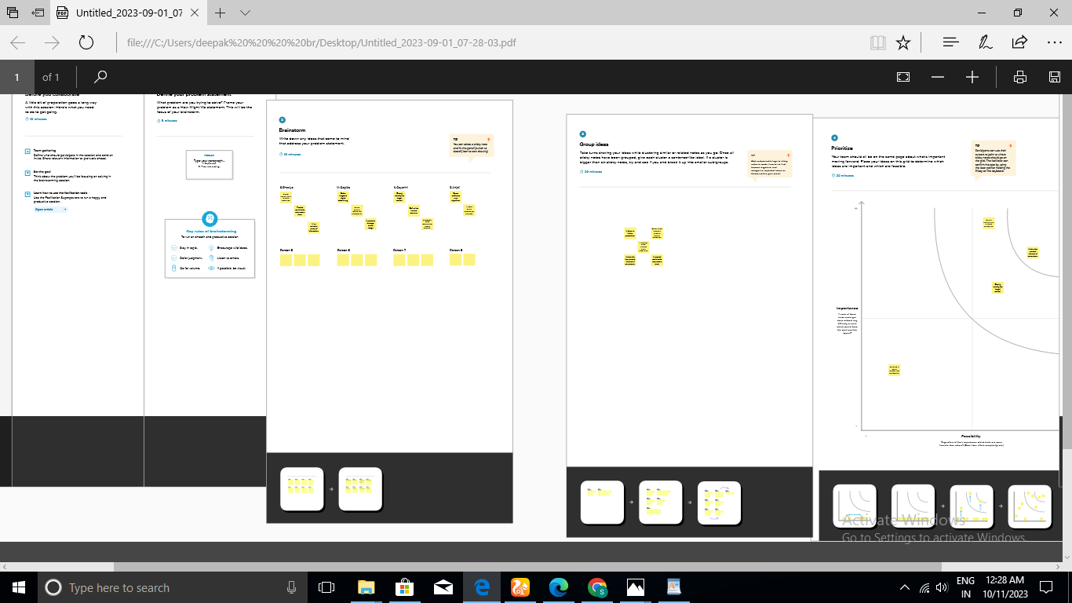
2.2 IDEATION AND BRAINSTORMING MAP

Slide 6
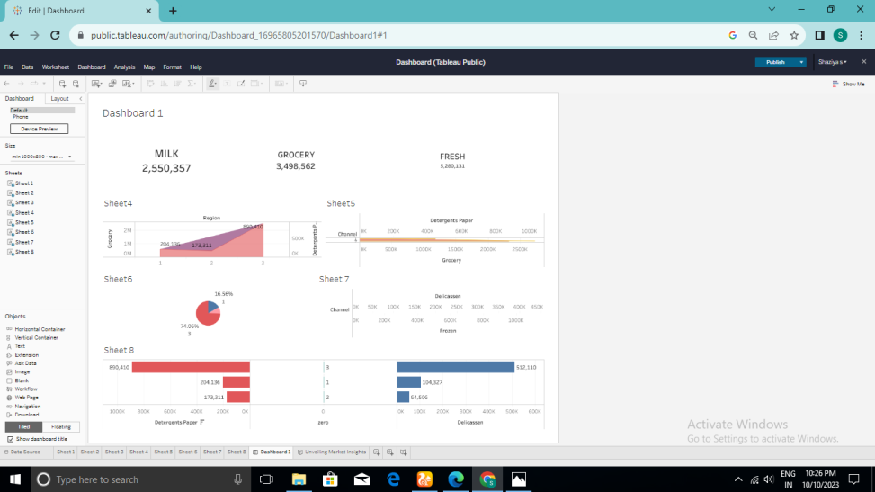
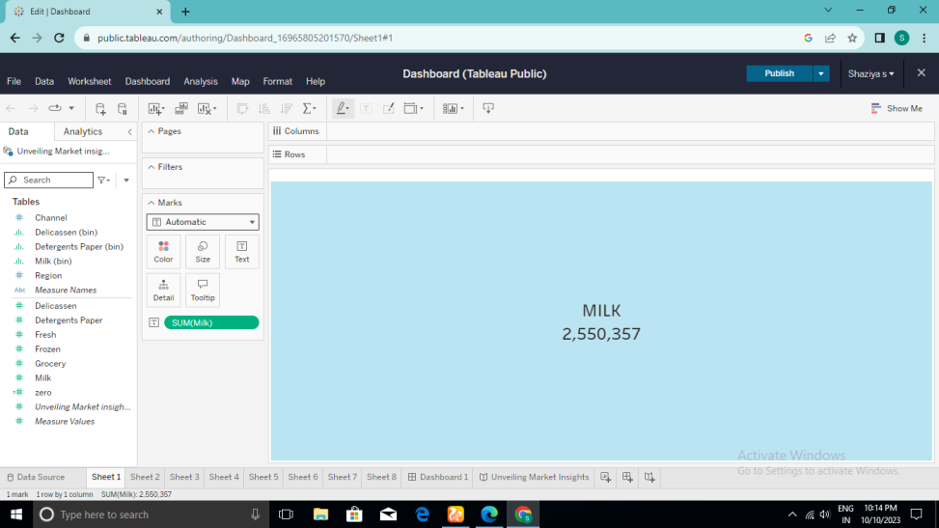
3. PROJECT OUTPUT

Slide 7
4. ADVANTAGES AND DISADVANTAGES
PROS
Market Insights spot trends and opportunities in industries
It benefit both categories
Increase efficiency and production
Cons
Implementing can be expensive, especially for smaller markets
Requires significant time investment.
May only target a small population

Slide 8
5. APPLICATIONS
Market Insights allow company to achieve greater scale
It detect more business opportunities
It minimize losses
It increases right technology
It provide the way to collect right data
It helps to lower down the risk in market.

Slide 9
6. CONCLUSION
Market Insights assist to get information from consumers about what kind of products or services they need currently
It ensure that market survives longer with stable flow of sales and customers
By concluding, it summarizes the target market.

Slide 10
FUTURE SCOPE
Artificial Intelligence (AI) are going to be used widely to analyze large data sets hence , in future these technologies could play an even larger role in market research
MOBILE RESEARCH: Mobile surveys and data collection methods will become more prevalent, making it easier for companies to capture information in real-time
Overall, the future of market research will be driven by technology and a focus on understanding customer needs and preferences.

